Slide 1


Avoiding Version Chaos in a Multi-Version World
June Blender
Technology Evangelist
SAPIEN Technologies, Inc.
Microsoft Cloud & Datacenter MVP
@juneb_get_help
Notes:
Embarassment of riches

Slide 2

Tested versions
The information in this presentation applies to:
Windows PowerShell 5.0.10586.122, 5.0.11082.1000, 5.0.14279.1000
5.1.14393.187, 5.1.14393.1000, 6.0.0.9, 6.0.0.10
Microsoft.PowerShell.Core\Get-Command, Get-Module, Import-Module 3.0.0.0
PowerShellGet 1.0.0.1
PackageManagement 1.0.0.1

Slide 3
Slides & Code for All Talks
https://github.com/juneb
https://github.com/juneb/AvoidVersionChaos
http://info.sapien.com

Slide 4
Many supported versions of Windows PowerShell
Windows PowerShell 2.0
Windows PowerShell 3.0
Windows PowerShell 4.0
Windows PowerShell 5.0.n.n
Windows PowerShell 5.1.n.n
PowerShell 6.0.0-alpha (6.0.0.9, 6.0.0.10, 6.0.0.11)

Slide 5
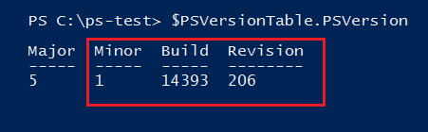
PowerShell 5.0 is not final
It changes with Windows Update
Minor, Build and Revision numbers in versions
PowerShell is backward-compatible. But, changes aren't backported.

Slide 6
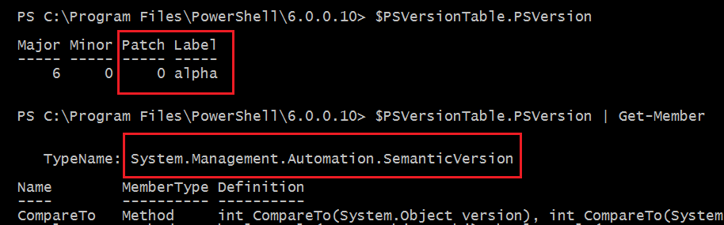
PowerShell 6.0 changes every day
Open source; daily builds
New version type: SemanticVersion

Slide 7
Modules are coming from more sources
Versioned, but might not be backward-compatible
Microsoft: In Windows
PowerShell Gallery
PowerShellGet: Other galleries
PackageManagement (OneGet)
GitHub
Friends, colleagues

Slide 8
Side-by-Side Module Versions
Beginning in Windows PowerShell 5.0, you can install different versions of the same module on the same computer.

Slide 9
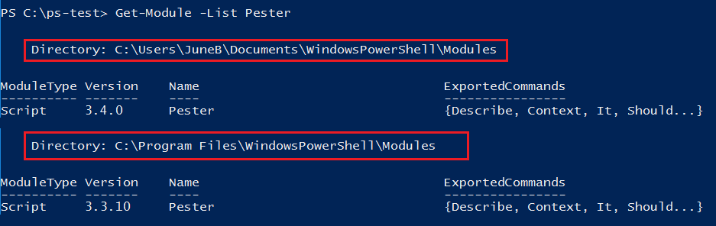
Different versions of the same module … in different paths

Slide 10
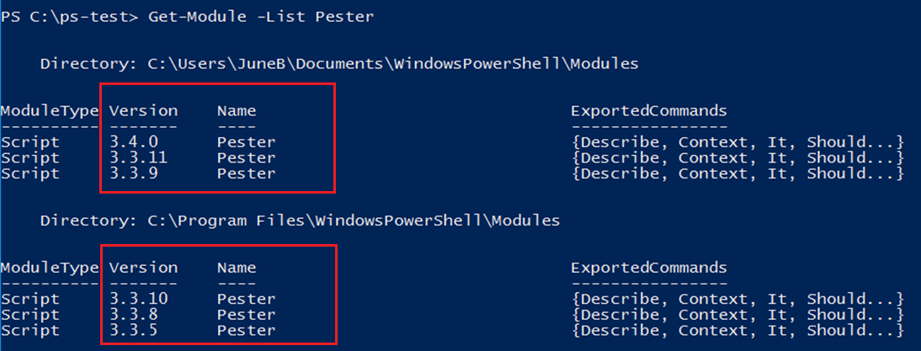
Different versions of the same module … in the same path

Slide 11
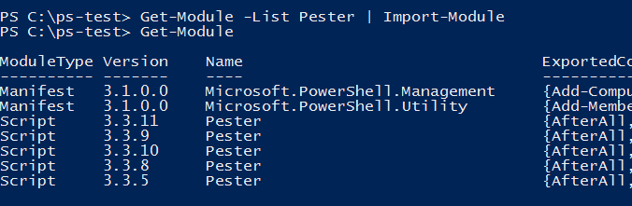
And, you can import them. Into the same session. All of them.

Slide 12
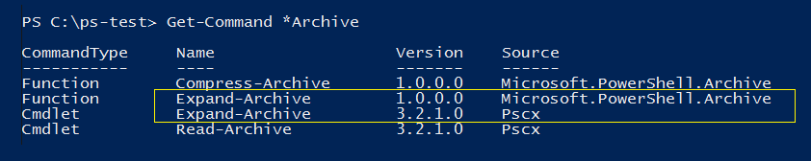
Commands with the same name in different modules
Module-qualified name: PSCX\Expand-Archive
Microsoft.PowerShell.Archive\Expand-Archive
Using-module-qualified-cmdlet-names

Slide 13
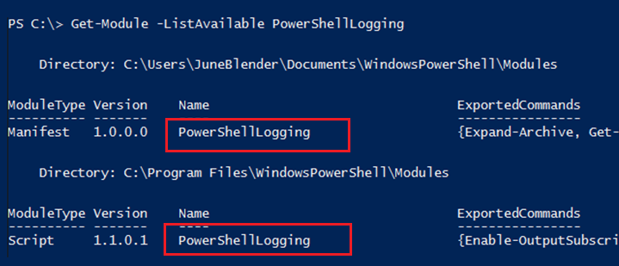
Different modules with same name
ModuleSpecification Object Import-Module @{ModuleName='PowerShellLogging; ModuleVersion = '1.1.0.1';
GUID = cb29d29a-7c53-4cbf-987d-d0b7b8d8983a }
Using-a-ModuleSpecification-Object

Slide 14
What could possibly go wrong?
Which version of PowerShell do I need?
Which version of a module is imported?
Which version of a command runs?
How do different versions differ?
How do I assure my script runs the command I want?

Slide 15
About_MyModule
TOPIC
About_MyModule
SHORT DESCRIPTION
…
This module requires Windows PowerShell 5.0.11086, PSCX 3.3.12,
PSLogging 2.5.3, and lots of luck.
Each of these modules requires other versions of other modules…

Slide 16
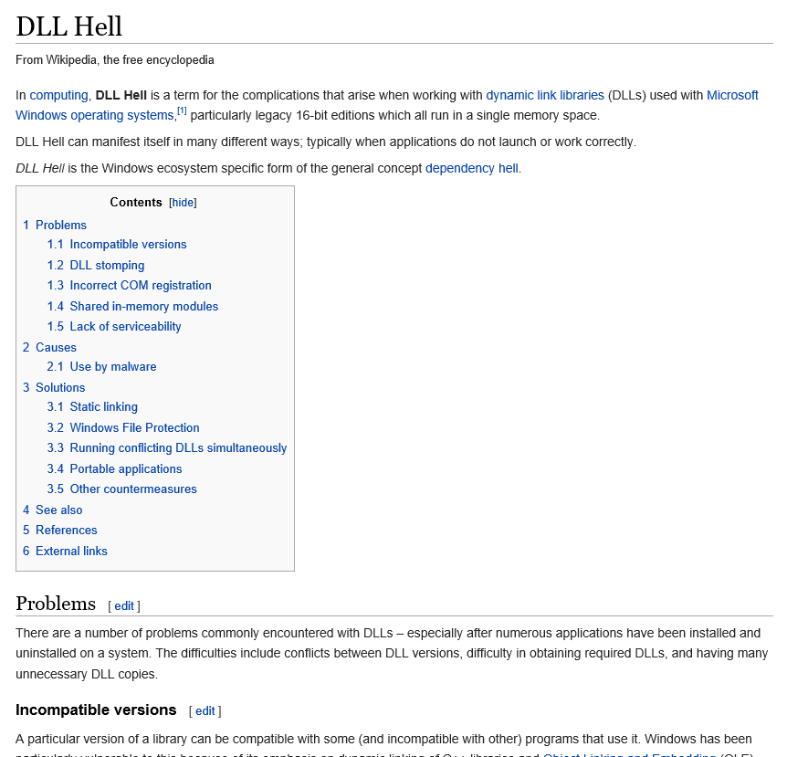
Notes:
This is not a protest.

Slide 17
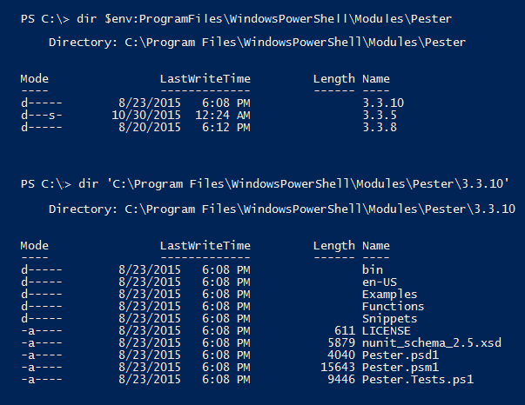
Side-by-side: How do they do it? "Version-Wrapped Modules"
Modules in a version subdirectory
DEMO
Notes:
Microsoft Health; dir (Get-Module MicrosoftHealth).ModuleBase Pester Get-Module Pester

Slide 18
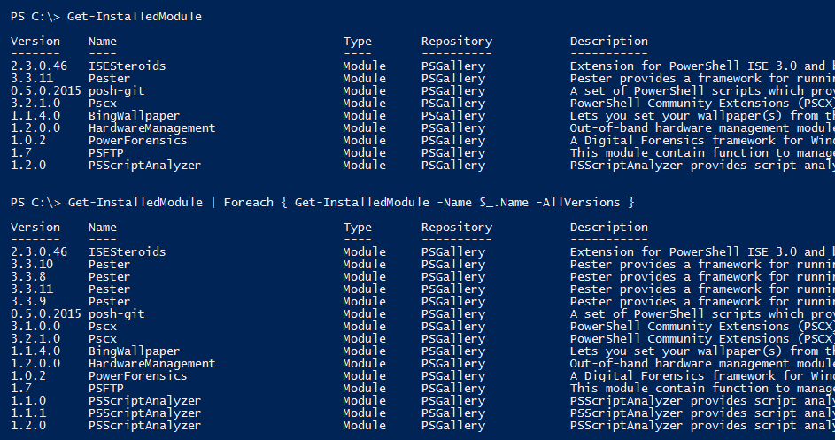
PowerShellGet on PowerShell 5.0+ Installs versioned modules
Not on <=4.0
Notes:
Get-InstalledModule : The RequiredVersion, MinimumVersion, MaximumVersion or AllVersions parameters are allowed only when you specify a single name as the value of the
Name parameter, without any wildcard characters.

Slide 19
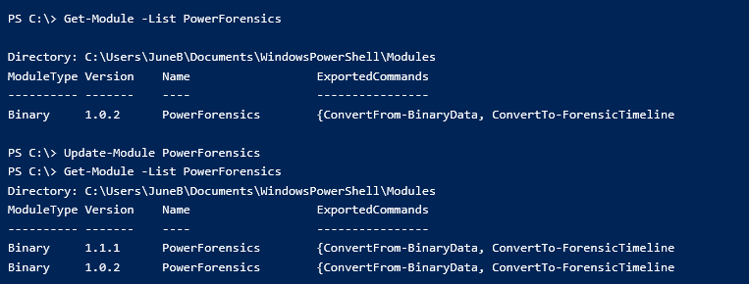
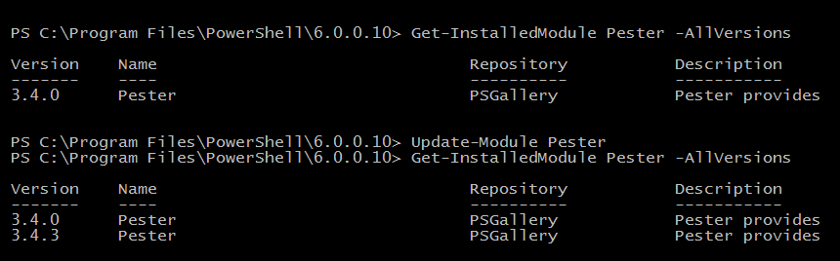
Update-Module in PowerShellGet
Adds the newest version of the module to the same directory
Update-module-5-0-adds-not-updates

Slide 20
Avoid Version Chaos
Require a version of Windows PowerShell
Require and/or import the versions of the modules you need
Specify the command that runs:
Module-qualified names
Fully-qualified names (with versions)
Prefixes
Add versions & dates help, blogs, videos

Slide 21
Require a version of PowerShell
Easy! #Requires -Version
DEMO
Notes:
Demo now!

Slide 22
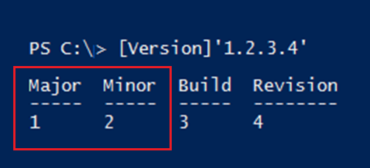
#Requires -Version
Specifies the minimum version (not a required version)
Inspects only Major and Minor properties, not Build or Revision.
Works on same way on 6.0+
Notes:
Test-PSVersionRequirement.ps1

Slide 23
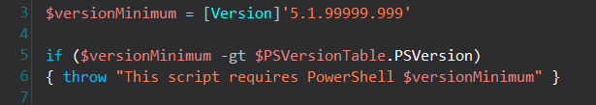
Require a version of PowerShell
To test major and minor build numbers, use #Requires -Version
To test build or revision, use:
-gt, -ge, -lt, -le, eq
$PSVersionTable.PSVersion.CompareTo( <version> )
Test on 2.0 - 6.0

Slide 24
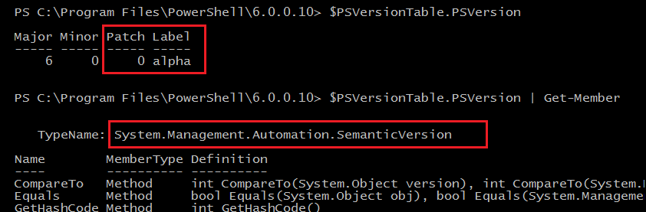
$PSVersionTable.PSVersion 6.0+
New type: System.Management.Automation.SemanticVersion
Notes:
Test-PSVersionRequirement.ps1

Slide 25
Semantic Versioning
Predictable, Meaningful
Agreement/contract about meaning of version numbers
Works only when everyone complies
Property | Increment when:
Major | Breaking change
Minor | New feature (backward-compatible)
Patch | Bug fix
Label | Pre-release and build metadata
Semantic Versioning 2.0.0 (specification)
https://www.sitepoint.com/semantic-versioning-why-you-should-using/
Notes:
Test-PSVersionRequirement.ps1

Slide 26
#Requires & SemanticVersion
#Requires -Version takes Version object, not SemanticVersion
#Requires -Version 6.0.0 #Not 6.0.0-alpha
To test Patch or Label, use: -lt, -le, eq
You can compare version strings to Version/SemanticVersion
Test on 2.0 - 6.0+
DEMO

Slide 27
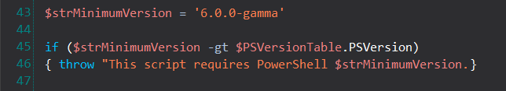
#Requires & SemanticVersion
You cannot create SemanticVersion on PS <6.0 (by default)
You can use Version object
You can use SemanticVersion string

Slide 28
I have my version of PowerShell
Now I want my modules
Release Notes
#Requires -Module
Using module (5.0+)
ModuleSpecification hash table
Version parameters

Slide 29
Find a module
Read the comments: NEW in PowerShell Gallery
Check release notes:
(Find-Module <Name>).ReleaseNotes
(Get-InstalledModule <Name>).ReleaseNotes
(Get-Module <Name>).ReleaseNotes
Check AdditionalMetadata:
All string values, case-sensitive
Get-release-notes
Notes:
Imports the newest module in the user module directory

Slide 30
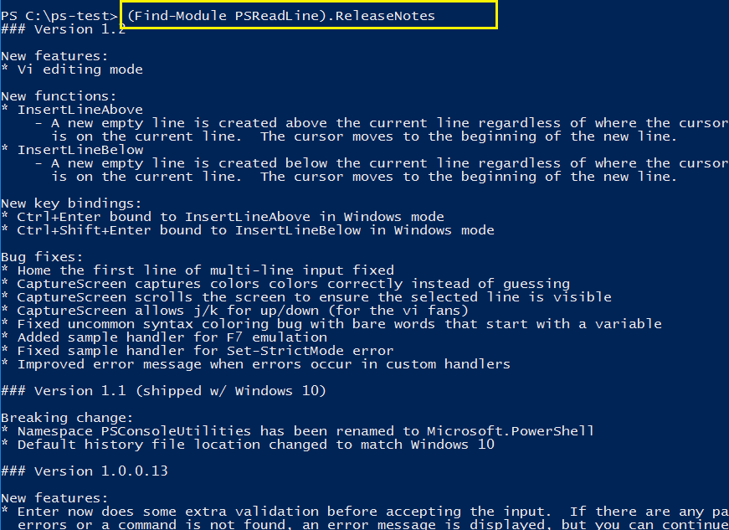
(Find-Module <Name>).ReleaseNotes
Get-release-notes

Slide 31
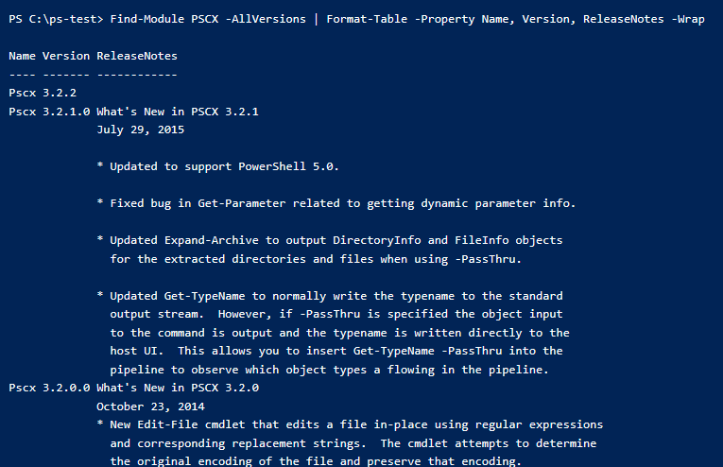
Find-Module <Name> -AllVersions | Format-Table Name, Version, ReleaseNotes -Wrap
Get-release-notes

Slide 32
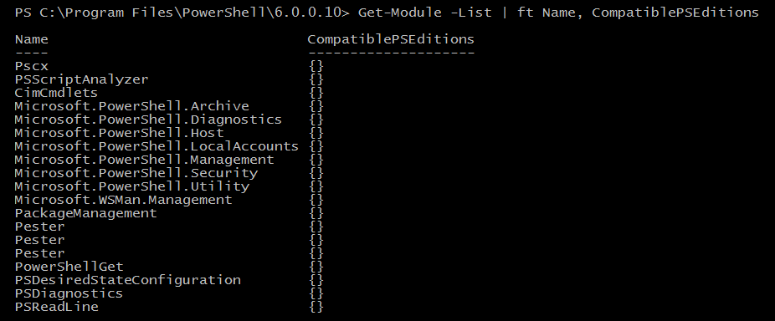
CompatiblePSEditions (5.1+ only)
Values are Desktop (Full PS), Core (Nano, IoT)
Module manifest key (not compatible before 5.1)

Slide 33
Require a module and version
#Requires (1.0+)
Using module (5.0)
Import-Module
Which-version-does-import-module-import
Notes:
Imports the newest module in the user module directory

Slide 34
Require a module: #Requires
#Requires -Module <String>
#Requires -Module <ModuleSpecification>
Imports the first version of the module that it discovers
($env:PSModulePath order)
Default behavior is same as Import-Module
Must be the first line in the script, else run first anyway! (5.0+)
Which-version-does-import-module-import
DEMO
Notes:
Let's see how Import-Module works.

Slide 35
Require a module: Using (5.0+)
Using module <String>
Using module <ModuleSpecification>
Imports the first version of the module that it discovers
($env:PSModulePath order)
Same as Import-Module
Imports classes defined in module
Must be the first line in the script, else error (parser warning!!)
Import-powershell-classes-from-modules
Notes:
Imports the newest module in the directory ($env:PSModulePath)

Slide 36
ModuleSpecification (3.0) [Microsoft.PowerShell.Commands.ModuleSpecification]
#Requires -Module
Using module (PS 5.0+)
Parameters: -FullyQualifiedName, -FullyQualifiedModule
@{ModuleName=<string>; ModuleVersion=<Version> [;GUID=<GUID>]}
@{ModuleName=<string>; MaximumVersion=<Version> [;GUID=<GUID>]}
@{ModuleName=<string>; RequiredVersion=<Version>[;GUID=<GUID>]} (5.0)
To test your module spec, cast it!
[Microsoft.PowerShell.Commands.ModuleSpecification]@{...}
DEMO

Slide 37
Require a module : Module Specification
#Requires -Module Pester
#Requires -Module @{ModuleName='Pester'; ModuleVersion='3.3.9'}
#Requires -Module @{ModuleName='Pester'; MaximumVersion='3.3.9'}
#Requires -Module @{ModuleName='Pester'; RequiredVersion='3.3.9'}
** ModuleVersion == MinimumVersion
** -Min/Max version don't import the earliest/latest version. They import the first version discovered that meets the requirements.
DEMO

Slide 38
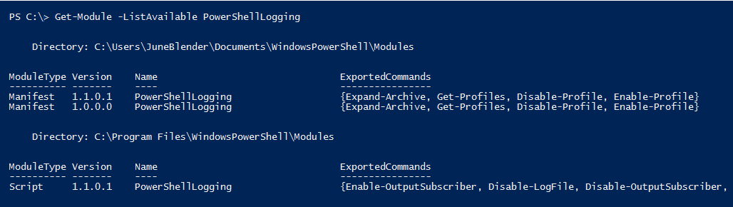
Use a GUID
Import-Module -FullyQualifedName @{ ModuleName = 'PowerShellLogging'; RequiredVersion = '1.1.0.1'; GUID = '345320b5-bdc3-4ab6-a13e-fcb019362fe6'}
* #Requires won't import non-default module. Use Import-Module.

Slide 39
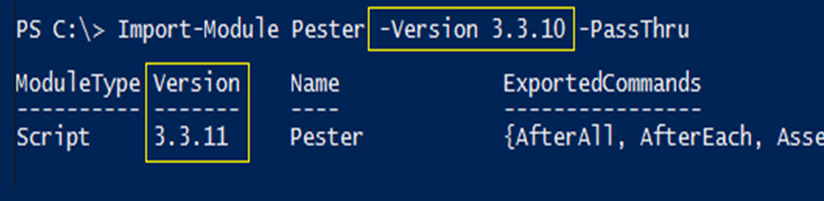
Version Parameters
-Version (3.0); Alias = MinimumVersion
-RequiredVersion (3.0)
-MaximumVersion (5.0)
-AllVersions (PowerShellGet, PackageManagement)
Notes:
Doesn't always import the latest: PSReadline

Slide 40
Cmdlets with Version Parameters
Find-DscResource
Find-Module
Find-Package
Find-PackageProvider
Find-Script
Get-InstalledModule
Get-InstalledScript
Get-Package
Install-Module
Install-Script
Install-Package
Install-PackageProvider
Import-Module
Import-PackageProvider
Save-Module
Publish-Module
Save-Package
Save-Script
Uninstall-Module
Uninstall-Package
Uninstall-Script
Update-Module
Update-Script
Update-ScriptFileInfo
Notes:
Doesn't always import the latest: PSReadline Get-Command -

Slide 41
Import-Module
Default: PSModulePath discovery order ($home\...\Modules)
# Imports the first conforming module it discovers
Version (minimum) imports first module >= version. (3.0+)
MaximumVersion imports the first module <= version. (5.0+)
RequiredVersion imports the specified version. (3.0+)
FullyQualifiedName takes ModuleSpecification object. (5.0+)
Which-version-does-import-module-import

Slide 42
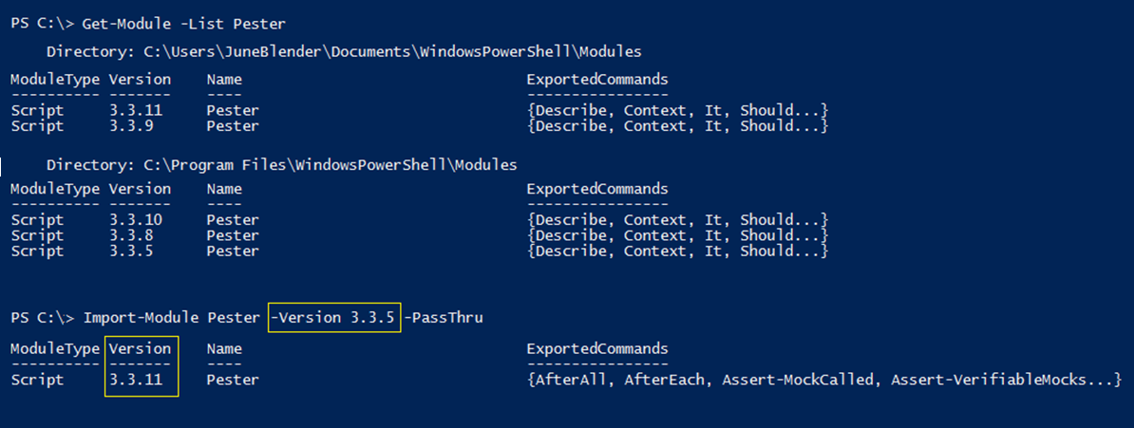
Import-Module -Min/Max version don't import the earliest/latest version. It imports the first version discovered that meets the specification.

Slide 43
Get-Module (4.0+) Remove-Module (5.0+)
-FullyQualifiedName <ModuleSpecification>
Get-Module -ListAvailable `
-FullyQualifiedName @{ModuleName='Pester'; ModuleVersion = '3.4.0';
GUID='a699dea5-2c73-4616-a270-1f7abb777e71'}
Remove-Module -FullyQualifiedName @{ModuleName='Pester'; RequiredVersion = '3.4.0'; GUID='a699dea5-2c73-4616-a270-1f7abb777e71'}
-Min/Max version don't import the earliest/latest version. -It imports the first version discovered that meets the specification.
-Doesn't trigger module autoload. Needs Import-Module.

Slide 44
Cmdlets with -FullyQualifiedName/Module
@{ModuleName=<string>; ModuleVersion=<Version> [;GUID=<GUID>]}
Get-Command
Get-Module
Import-Module
Remove-Module
Export-PSSession
Import-PSSession
Save-Help
Update-Help

Slide 45
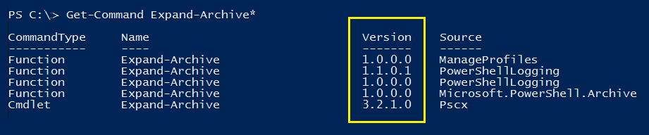
Get the Right Command

Slide 46
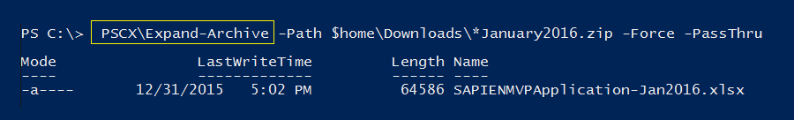
Run the right command
Module-qualified commands
Fully qualified command (ModuleSpecification)
Using-module-qualified-cmdlet-names

Slide 47
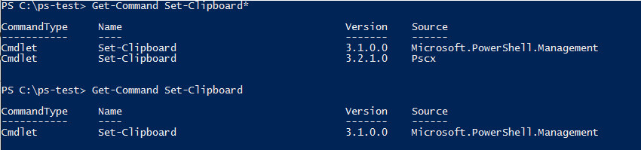
Command Precedence (in the session)
Commands with the same name: Use type to decide. Alias -> Function -> Cmdlet -> Native Windows command
Command with same name and type:
Command added to session last
Which command will run? Get-Command (no wildcards)
about_Command_Precedence
Notes:
No demo. Keep going.

Slide 48
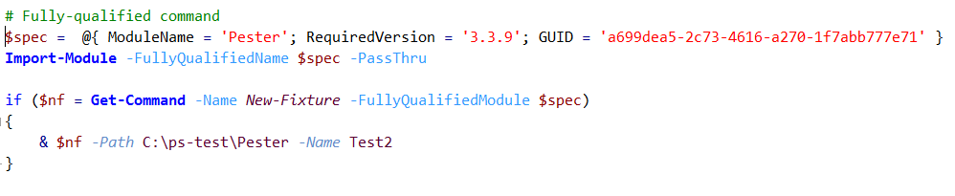
Run the right command
Module-qualified command: <Module>\<Command>
Fully-qualified command: & Get-Command <ModuleSpecification>

Slide 49
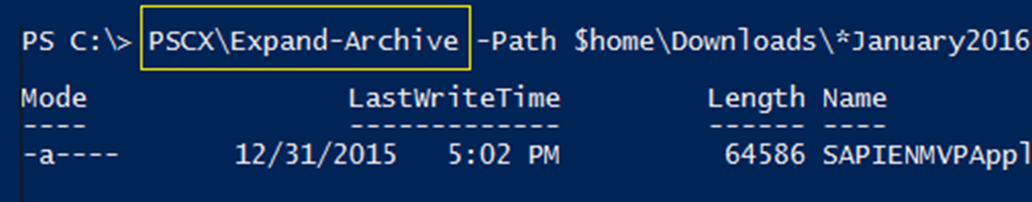
When module name is ambiguous, use module-qualified command...
SYNTAX: <ModuleName>\<CommandName>
EXAMPLE: PSCX\Expand-Archive # No version qualifier
Using-module-qualified-cmdlet-names

Slide 50
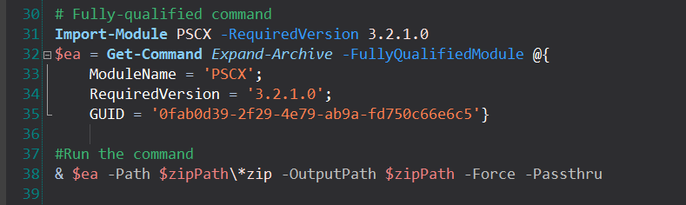
When the version or guid is ambiguous, use fully-qualified command
1. Get-Command -FullyQualifiedModule <ModuleSpecification> 2. Invoke operator: & (Get-Command...)
* Does not trigger module autoload. Need Import-Module
DEMO*2

Slide 51
Taming the Beast: Avoid Version Chaos
Require a version of PowerShell
Require and import the versions of the modules you need
Specify the command that runs:
Module-qualified names
Fully-qualified names (with versions)
Add version info & dates to help, blogs, videos

Slide 52
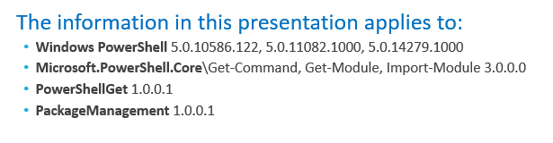
Call to Action: Blogs, Talks, and Videos
Date of publication, latest update
PowerShell version
Module versions

Slide 53
Avoiding Version Chaos in a Multi-Version World
June Blender
Technical Evangelist
SAPIEN Technologies, Inc.
Windows PowerShell MVP
@juneb_get_help
Notes:
Embarassment of riches

